Slide 1
Module 4: Component Mode Synthesis

Slide 2
CMS: Outline
The “What” and “Why” of Component Mode Synthesis
Theory and Examples with Free-Boundary CMS
Modal Truncation Example

Slide 3
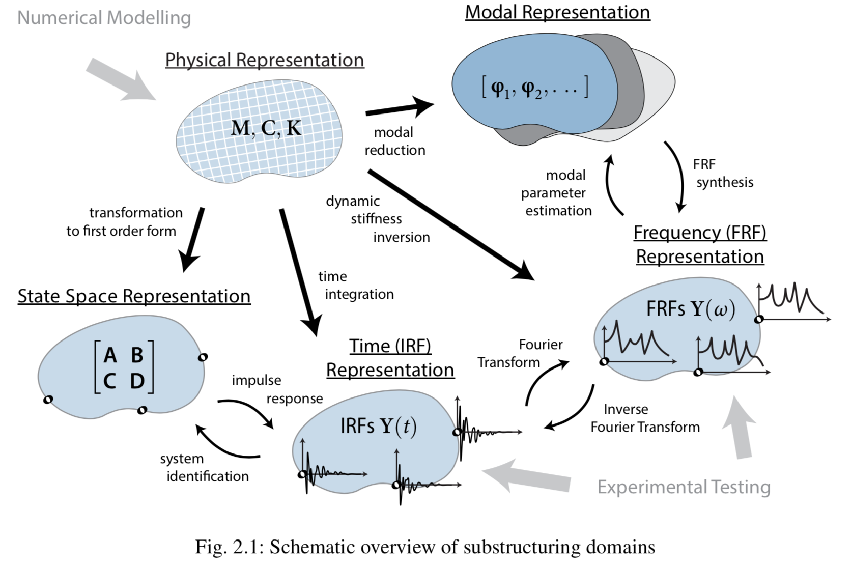
Domains for Substructuring
large unwieldy matrices
difficult interface measurements

Slide 4
Domains for Substructuring
Substructuring may seem simple with small spring-mass systems.
Unfortunately most industrial problems involve complex assemblies of intricate subsystems and components.
The physical mass and stiffness matrices can be quite cumbersome to use for physical coupling.
Wouldn’t it be nice if we could couple two reduced-order models (ROMs) of our systems so that the dynamic information we care about is preserved but the computational costs were small?

Slide 5
The “What” and “Why” of Component Mode Synthesis

Slide 6
CMS Basics
Component mode synthesis aims to couple two components (or subsystems) through a pair of reduced-order models.

Slide 7
CMS Basics
Component mode synthesis aims to couple two components (or subsystems) through a pair of reduced-order models.
A reduced-order model is a simpler representation of a mechanical system often viewed through a set of basis-vectors. Choosing which vectors to keep or remove provides ample means of model reduction.

Slide 8
CMS Basics
Component mode synthesis aims to couple two components (or subsystems) through a pair of reduced-order models.
A reduced-order model is a simpler representation of a mechanical system often viewed through a set of basis-vectors. Choosing which vectors to keep or remove provides ample means of model reduction.
Transforming form physical to our selected ROM basis set will be essential to our success at using CMS.
For this class, we will look at free-boundary modal models as a ROM for CMS

Slide 9
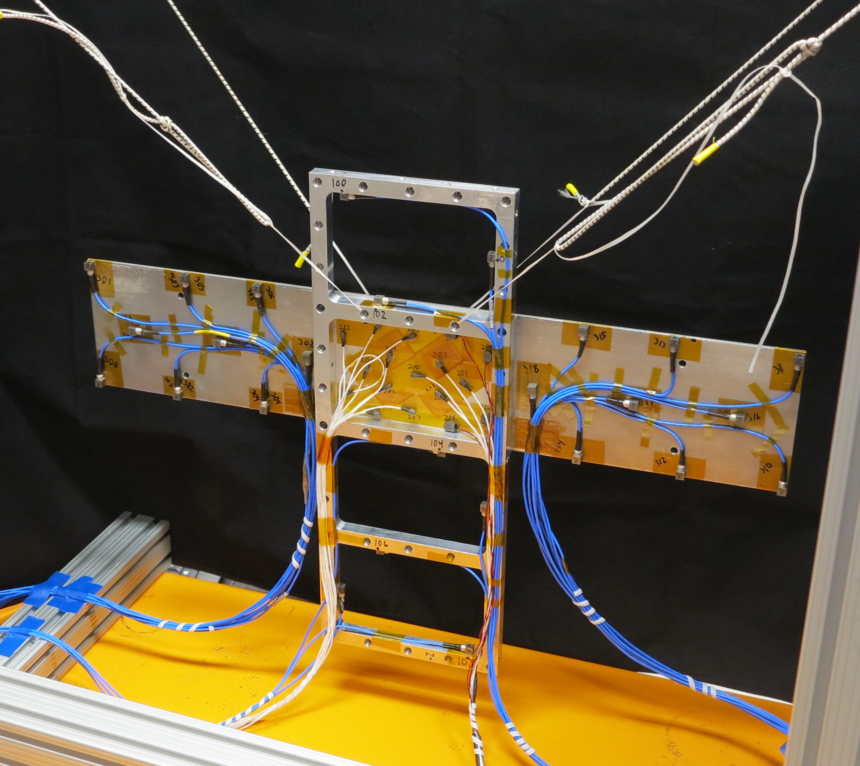
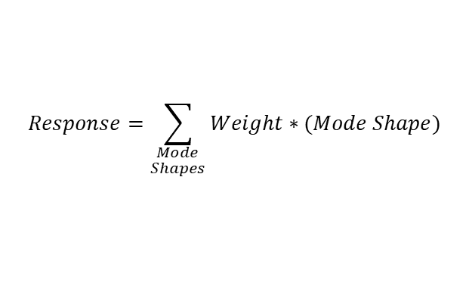
What are modes?
Modes are inherent physical properties of all objects
Describe how objects naturally respond to stimulation at different frequencies
The fundamental building blocks of all complex dynamic response
All complex dynamic behavior is a linear superposition of modal responses
$$Response=\sum_{\begin{aligned}Mode \\ Shapes\end{aligned}}{Weight∗(Mode Shape)}$$
Response
=
Mode 1
Individual Modal Deflection Shapes
+
Mode 2
+
Mode 3
…

Slide 10
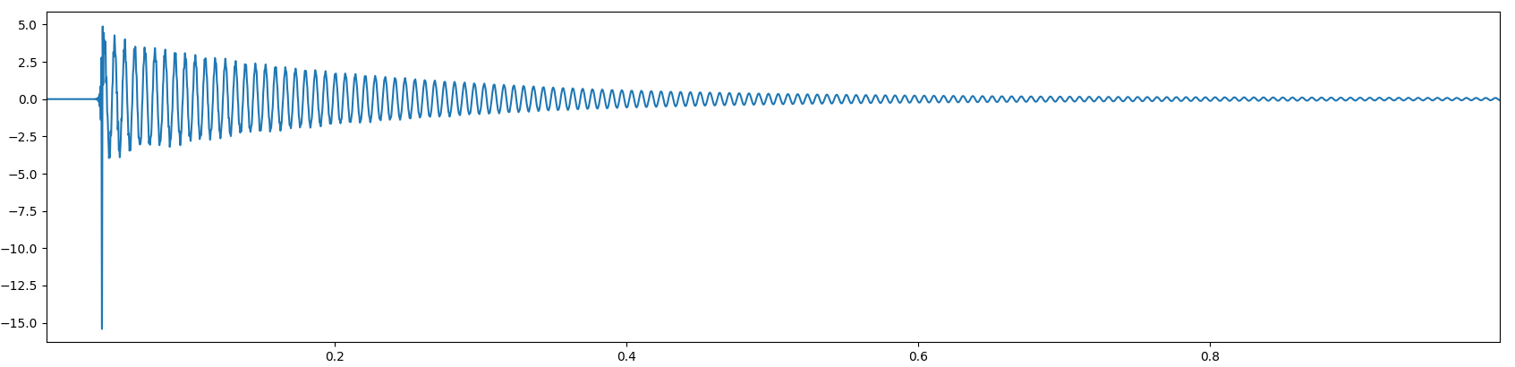
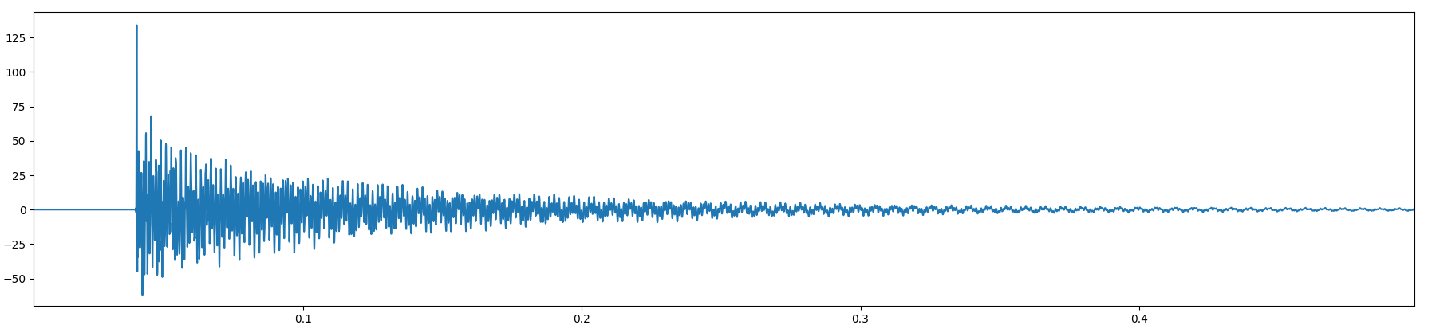
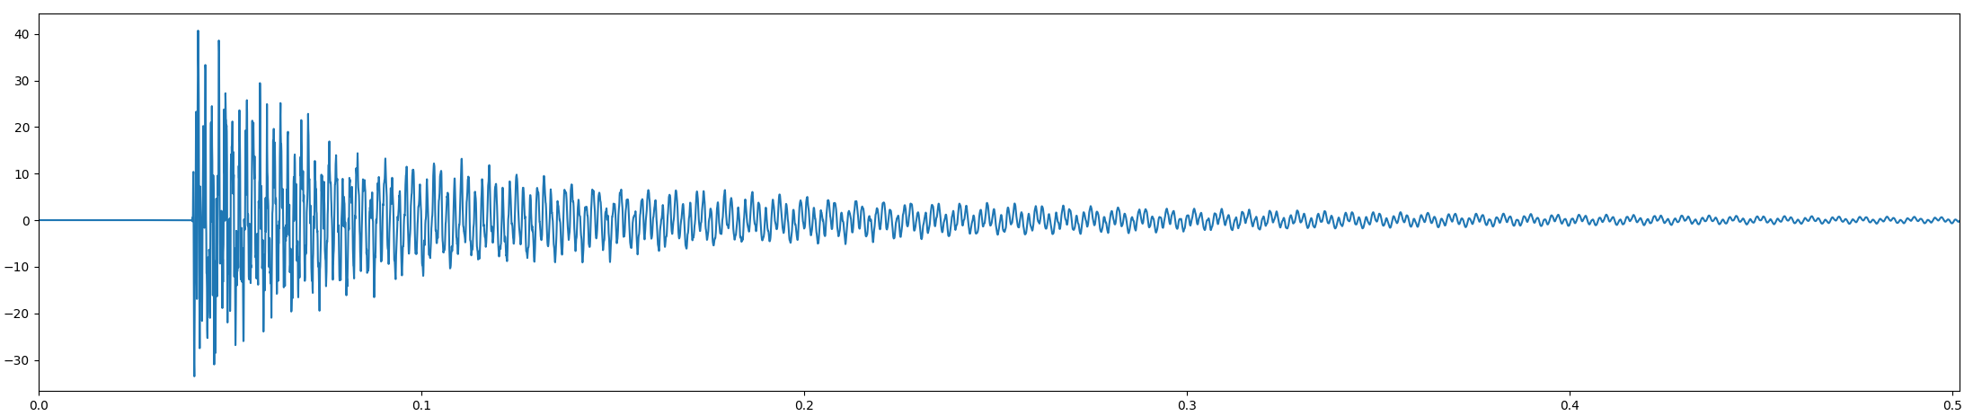
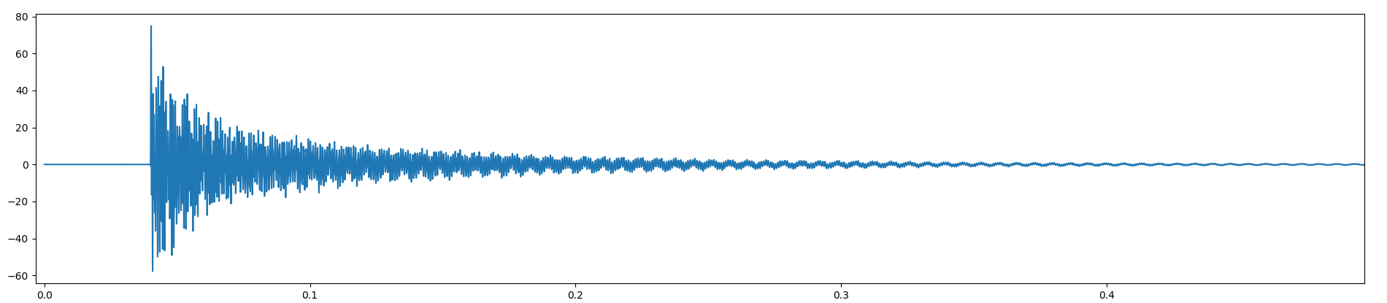
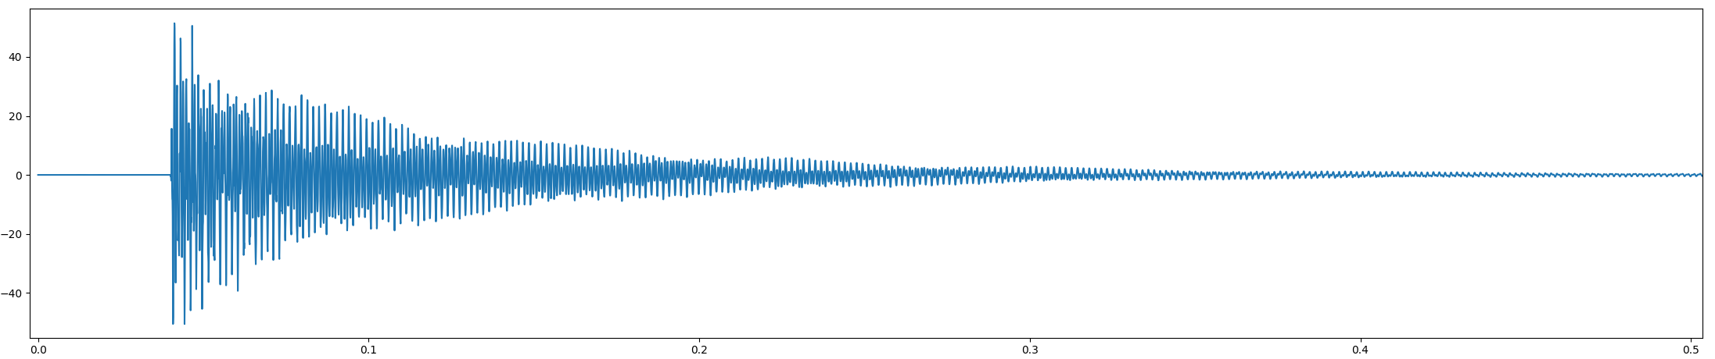
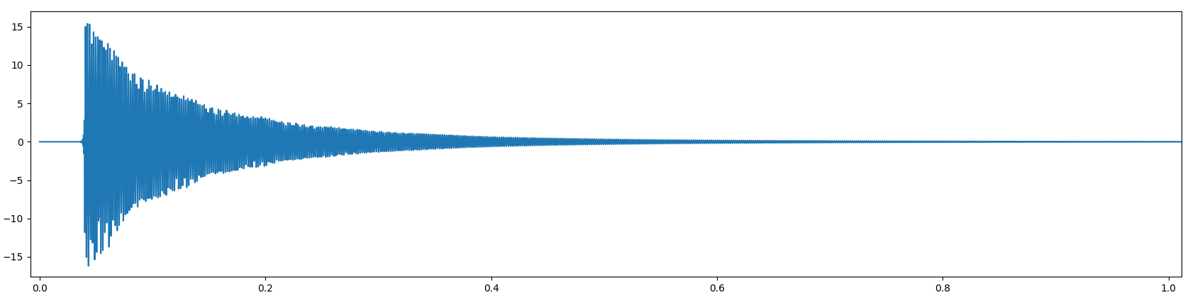
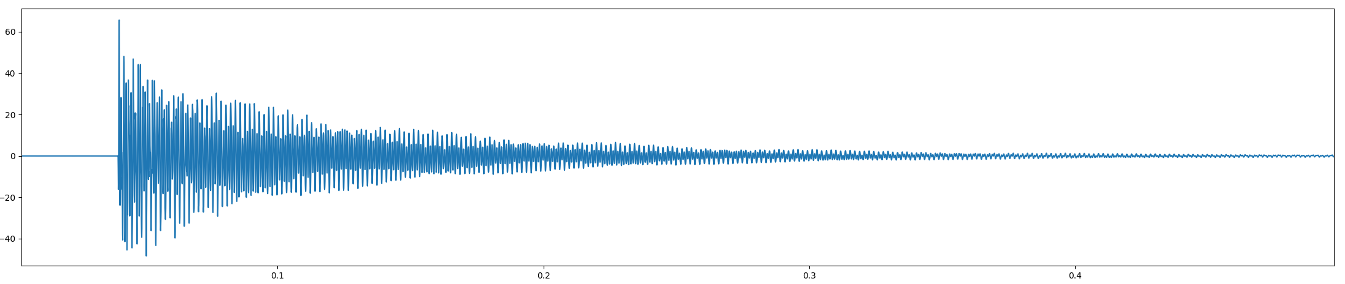
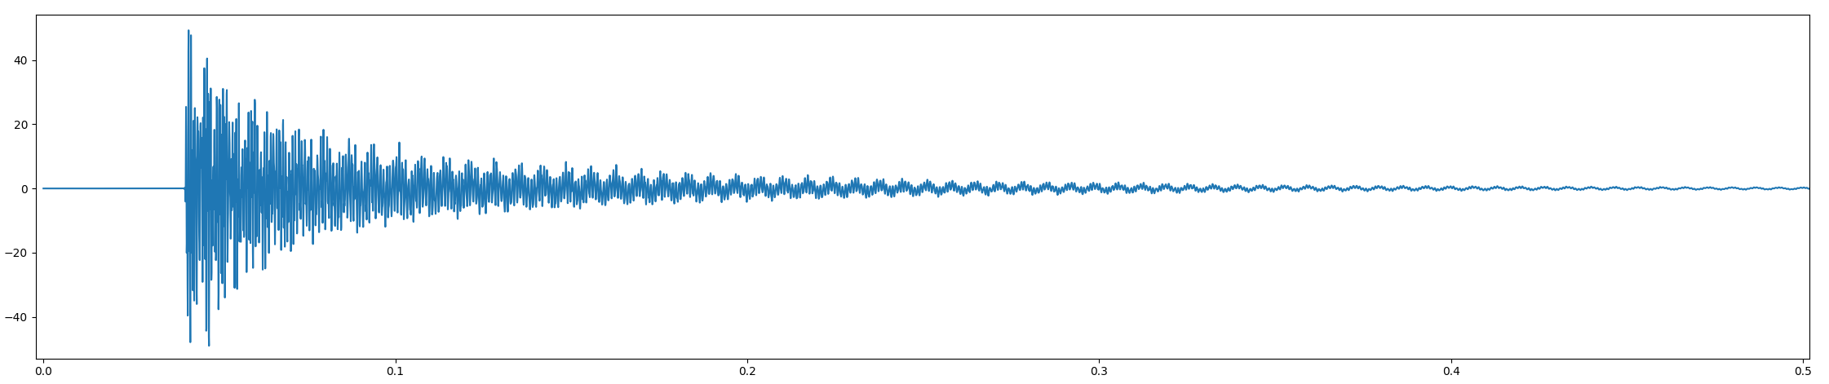

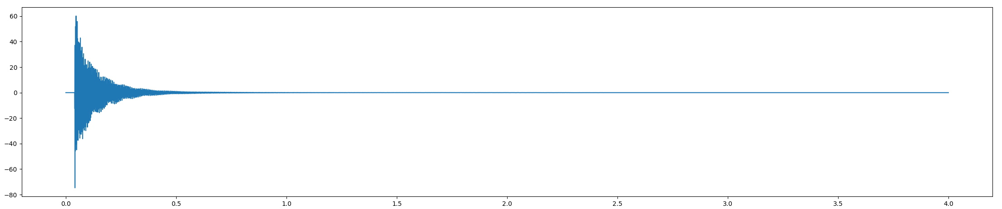
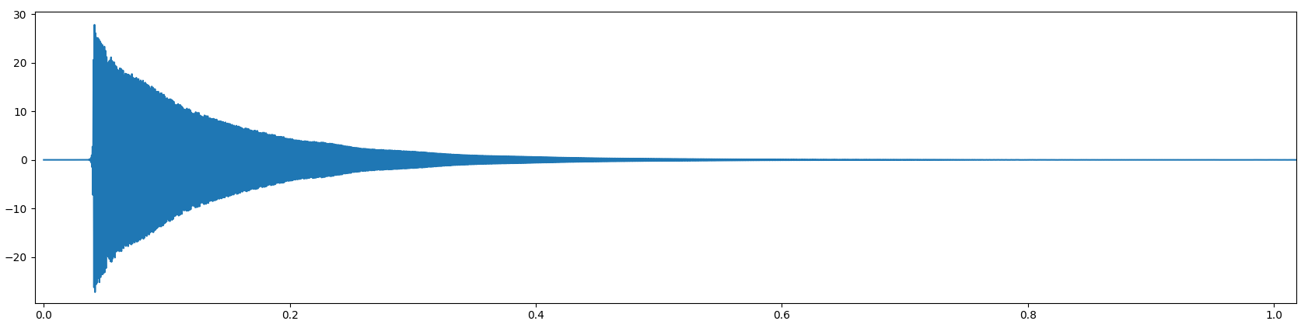

Modal Reduction?
We take many responses in the physical domain…
Modal Domain
Physical Domain
Sensor 101
Sensor 105
q1 Response
Sensor 102
Sensor 106
Sensor 103
Sensor 107
q2 Response
$$x=φq$$
Sensor 104
Sensor 108
q3 Response
Time [s]
and apply a modal transformation to convert to the modal domain.
If we retain all of the modes this is exact – this is where we use engineering judgement to select the right modes to reduce the model size while retaining prediction accuracy

Slide 11
Informal Formal Discussion
What size finite element models do your normally see in your field of work?
How many modes of interest are there?
Are modes typically measured to update/validate your finite element models?

Slide 12
Theory and Examples with CMS

Slide 13
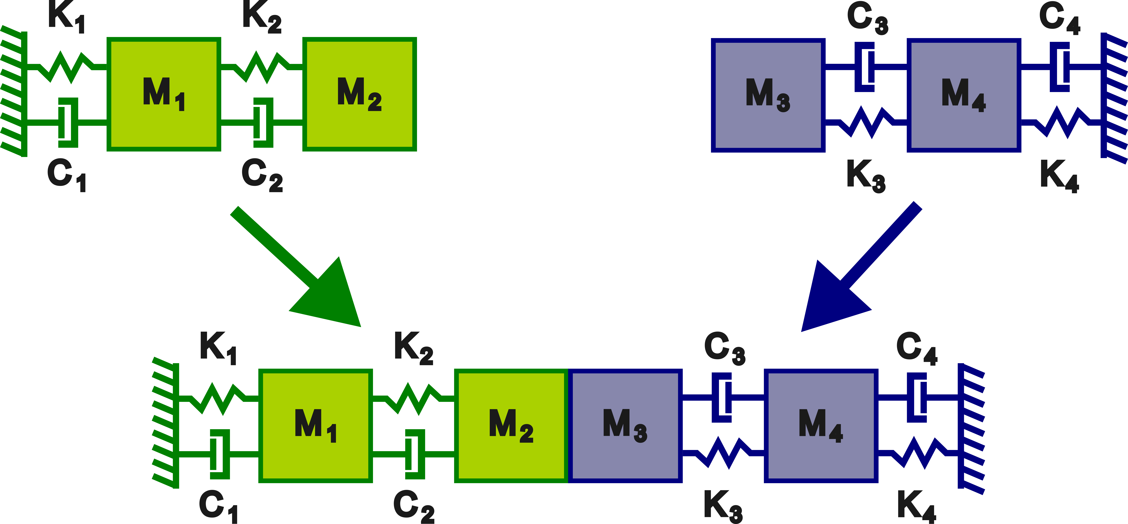
Example System for CMS
Let’s look at the same example

Slide 14
Three Steps to Substructuring with CMS
Step 1) Define Uncoupled Equations of Motion (but in the modal domain)
$$\left[\begin{matrix}I_{a} & 0 \\ 0 & I_{b}\end{matrix}\right]\left\{\begin{matrix}\ddot{q_{a}} \\ \ddot{q_{b}}\end{matrix}\right\}+\left[\begin{matrix}2{\text{ζ}}_{a}ω_{n,a} & 0 \\ 0 & 2{\text{ζ}}_{b}ω_{n,b}\end{matrix}\right]\left\{\begin{matrix}\dot{q_{a}} \\ \dot{q_{b}}\end{matrix}\right\}+\left[\begin{matrix}ω_{n,a}^{2} & 0 \\ 0 & ω_{n,b}^{2}\end{matrix}\right]\left\{\begin{matrix}q_{a} \\ q_{b}\end{matrix}\right\}=\left\{\begin{matrix}φ_{a}^{T}F_{a} \\ φ_{b}^{T}F_{b}\end{matrix}\right\}$$
Block diagonal identity matrix
Modal damping
Natural Frequency
Applied modal forces
Whoa, whoa, whoa… where did this equation come from?

Slide 15

Three Steps to Substructuring with CMS
Physical Domain Description of System a
$$\left[\begin{matrix}M_{1} & 0 \\ 0 & M_{2}\end{matrix}\right]\left\{\begin{matrix}\ddot{x_{1}} \\ \ddot{x_{2}}\end{matrix}\right\}+\left[\begin{matrix}C_{1}+C_{2} & −C_{2} \\ −C_{2} & C_{2}\end{matrix}\right]\left\{\begin{matrix}\dot{x_{1}} \\ \dot{x_{2}}\end{matrix}\right\}+\left[\begin{matrix}K_{1}+K_{2} & −K_{2} \\ −K_{2} & K_{2}\end{matrix}\right]\left\{\begin{matrix}x_{1} \\ x_{2}\end{matrix}\right\}=\left\{\begin{matrix}F_{1} \\ F_{2}\end{matrix}\right\}$$
Apply modal transform
$$\left[\begin{matrix}M_{1} & 0 \\ 0 & M_{2}\end{matrix}\right]φ_{a}\left\{\begin{matrix}\ddot{q_{1}} \\ \ddot{q_{2}}\end{matrix}\right\}+\left[\begin{matrix}C_{1}+C_{2} & −C_{2} \\ −C_{2} & C_{2}\end{matrix}\right]φ_{a}\left\{\begin{matrix}\dot{q_{1}} \\ \dot{q_{2}}\end{matrix}\right\}+\left[\begin{matrix}K_{1}+K_{2} & −K_{2} \\ −K_{2} & K_{2}\end{matrix}\right]φ\left\{\begin{matrix}q_{1} \\ q_{2}\end{matrix}\right\}=\left\{\begin{matrix}F_{1} \\ F_{2}\end{matrix}\right\}$$
$$x=φq$$
Pre-multiply by Phi-transpose
$$φ_{a}^{T}\left[\begin{matrix}M_{1} & 0 \\ 0 & M_{2}\end{matrix}\right]φ_{a}\left\{\begin{matrix}\ddot{q_{1}} \\ \ddot{q_{2}}\end{matrix}\right\}+φ_{a}^{T}\left[\begin{matrix}C_{1}+C_{2} & −C_{2} \\ −C_{2} & C_{2}\end{matrix}\right]φ_{a}\left\{\begin{matrix}\dot{q_{1}} \\ \dot{q_{2}}\end{matrix}\right\}+φ_{a}^{T}\left[\begin{matrix}K_{1}+K_{2} & −K_{2} \\ −K_{2} & K_{2}\end{matrix}\right]φ\left\{\begin{matrix}q_{1} \\ q_{2}\end{matrix}\right\}=φ_{a}^{T}\left\{\begin{matrix}F_{1} \\ F_{2}\end{matrix}\right\}$$
$$\left[\begin{matrix}I_{a} & 0 \\ 0 & I_{b}\end{matrix}\right]\left\{\begin{matrix}\ddot{q_{a}} \\ \ddot{q_{b}}\end{matrix}\right\}+\left[\begin{matrix}2{\text{ζ}}_{a}ω_{n,a} & 0 \\ 0 & 2{\text{ζ}}_{b}ω_{n,b}\end{matrix}\right]\left\{\begin{matrix}\dot{q_{a}} \\ \dot{q_{b}}\end{matrix}\right\}+\left[\begin{matrix}ω_{n,a}^{2} & 0 \\ 0 & ω_{n,b}^{2}\end{matrix}\right]\left\{\begin{matrix}q_{a} \\ q_{b}\end{matrix}\right\}=\left\{\begin{matrix}φ_{a}^{T}F_{a} \\ φ_{b}^{T}F_{b}\end{matrix}\right\}$$
Repeat for each subsystem and stack matrices in block diagonal form

Slide 16



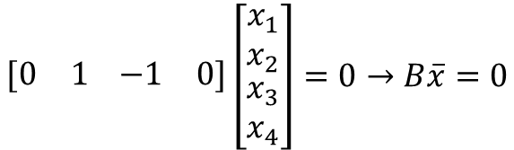
Three Steps to Substructuring with CMS
Step 2) Define constraints in physical domain then cast to ROM coordinates
$$x_{2}=x_{3}$$
$$\begin{matrix}[0 & 1\end{matrix}\begin{matrix} −1 & 0]\end{matrix}\left[\begin{aligned}\begin{matrix}x_{1} \\ x_{2}\end{matrix} \\ x_{3} \\ x_{4}\end{aligned}\right]=0→B\overline{x}=0$$
$$x=φq$$
$$\begin{matrix}[0 & 1\end{matrix}\begin{matrix} −1 & 0]\end{matrix}\left[\begin{matrix}φ_{a} & 0 \\ 0 & φ_{b}\end{matrix}\right]\left[\begin{aligned}q_{A} \\ q_{B}\end{aligned}\right]=0→\tilde{B}\overline{q}=0$$
Again we’ll use the modal transform to cast our coordinates into the ROM space

Slide 17



Three Steps to Substructuring with CMS
Step 3) Enforce constraints to convert our uncoupled equations into a synthesized form
$$q=Lη$$
$$\tilde{B}\overline{q}=0→ \tilde{B}Lη=0$$
$$L=null(\tilde{B})$$
Uncoupled ROM coordinates
New coupled coordinates
$$L^{T}\left[\begin{matrix}I_{a} & 0 \\ 0 & I_{b}\end{matrix}\right]L\left\{\begin{matrix}\ddot{η_{a}} \\ \ddot{η_{b}}\end{matrix}\right\}+L^{T}\left[\begin{matrix}2{\text{ζ}}_{a}ω_{n,a} & 0 \\ 0 & 2{\text{ζ}}_{b}ω_{n,b}\end{matrix}\right]L\left\{\begin{matrix}\dot{η_{a}} \\ \dot{η_{b}}\end{matrix}\right\}+L^{T}\left[\begin{matrix}ω_{n,a}^{2} & 0 \\ 0 & ω_{n,b}^{2}\end{matrix}\right]L\left\{\begin{matrix}η_{a} \\ η_{b}\end{matrix}\right\}=L^{T}\left\{\begin{matrix}φ_{a}^{T}F_{a} \\ φ_{b}^{T}F_{b}\end{matrix}\right\}$$

Slide 18
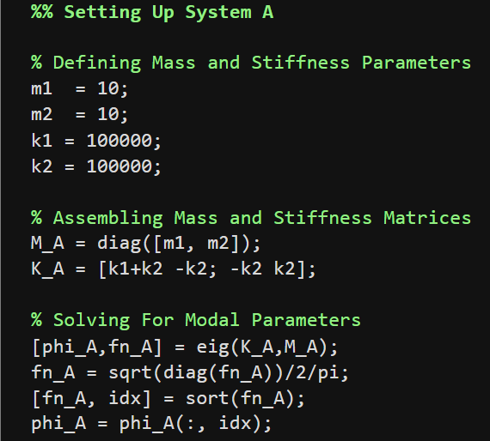
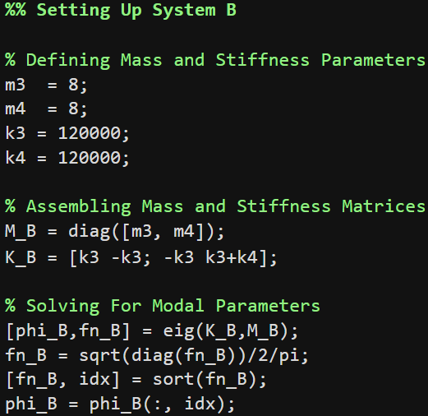
2 DOF Example in MATLAB

Slide 19
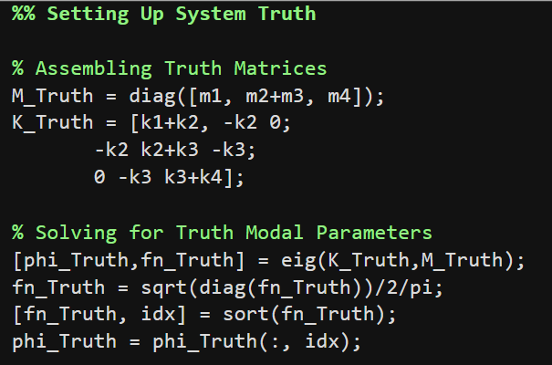
Truth Assembly

Slide 20
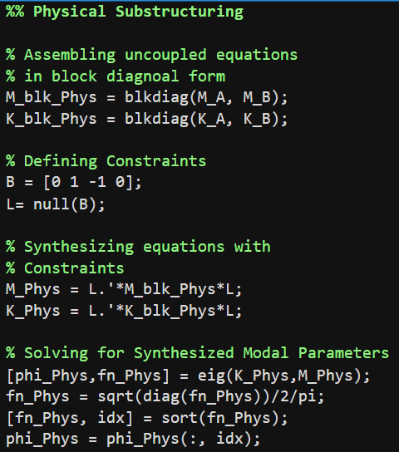
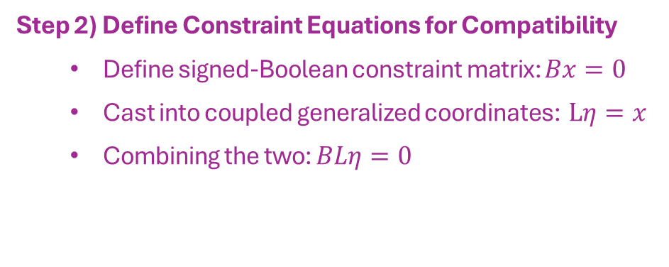

Physical Substructuring
Step 1) Define Uncoupled Equations of Motion
Block diagonal matrices for each subsystem
Step 2) Define Constraint Equations for Compatibility
Define signed-Boolean constraint matrix: $Bx=0$
Cast into coupled generalized coordinates: $Lη=x$
Combining the two: $BLη=0$
Step 3) Synthesize Equations of motion
Transform out equations using the $L$ matrix
Solve the synthesized eigen problem to reveal the assembled modes

Slide 21
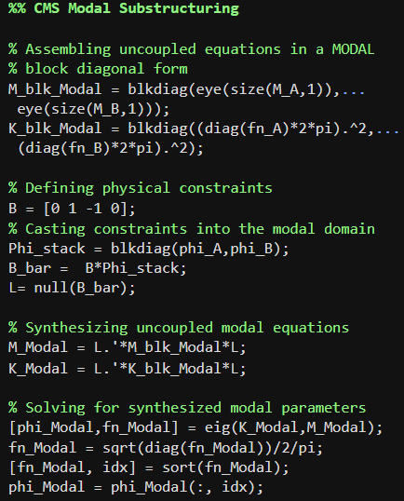
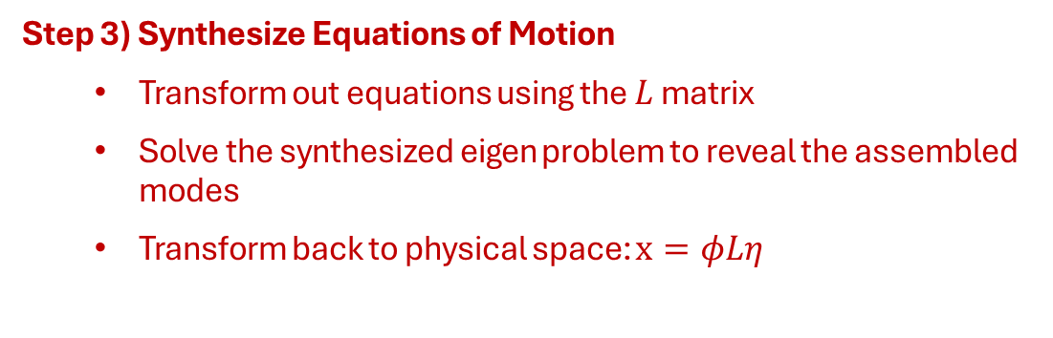
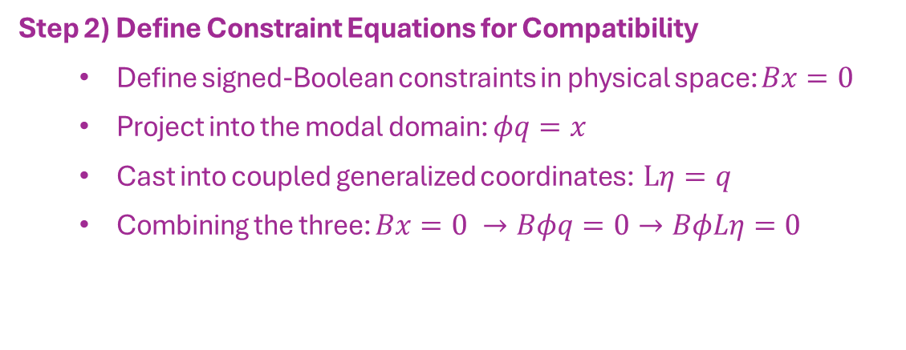
Modal Substructuring
Step 1) Define Uncoupled Equations of Motion in Modal Space
Block diagonal matrices for each subsystem as modal equations of motion
Step 2) Define Constraint Equations for Compatibility
Define signed-Boolean constraints in physical space: $Bx=0$
Project into the modal domain: $φq=x$
Cast into coupled generalized coordinates: $Lη=q$
Combining the three: $Bx=0 →Bφq=0→BφLη=0$
Step 3) Synthesize Equations of Motion
Transform out equations using the $L$ matrix
Solve the synthesized eigen problem to reveal the assembled modes
Transform back to physical space: $x=φLη$

Slide 22
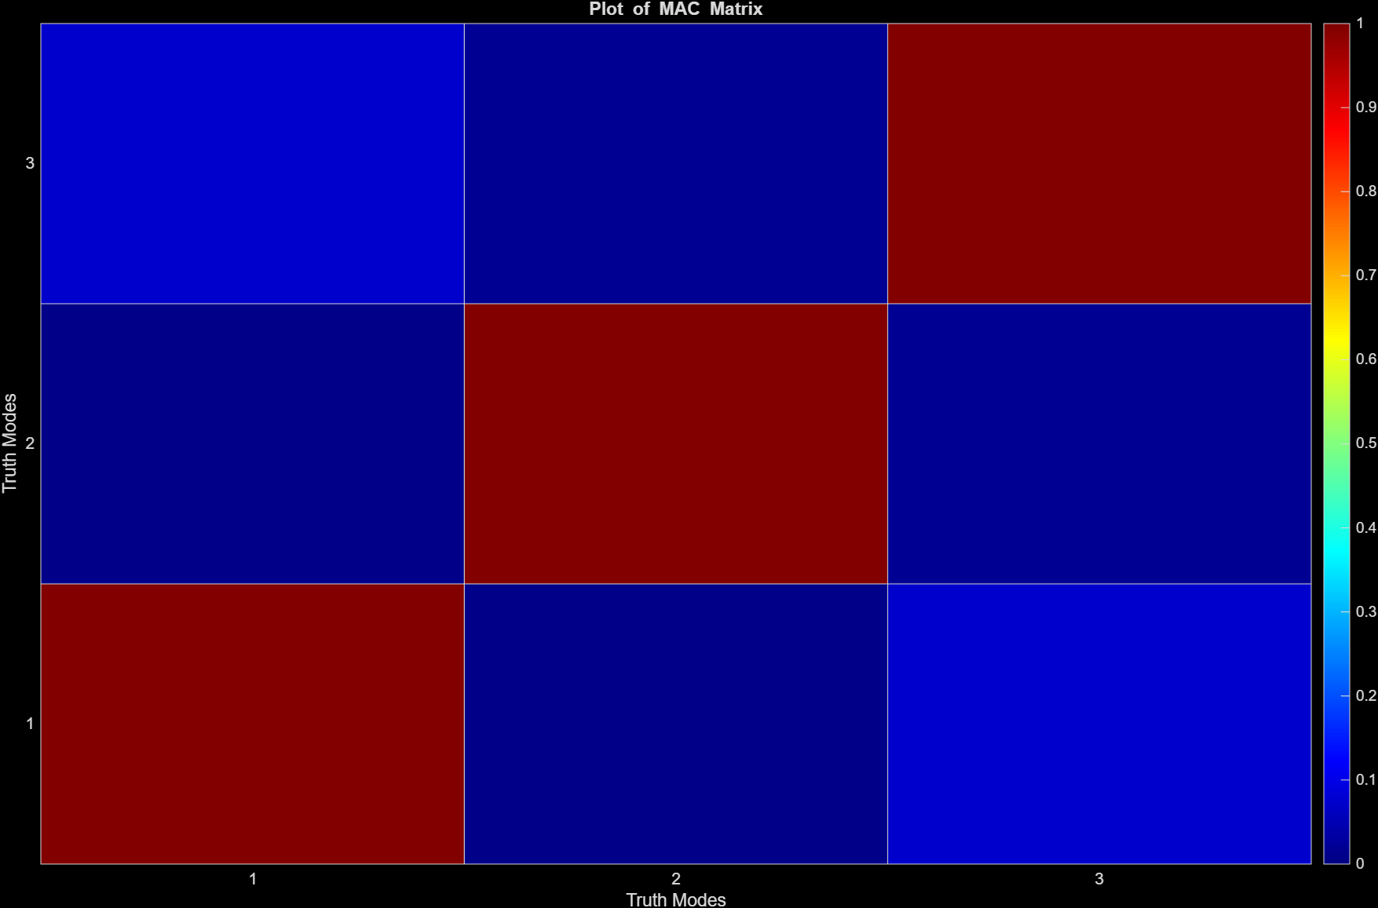
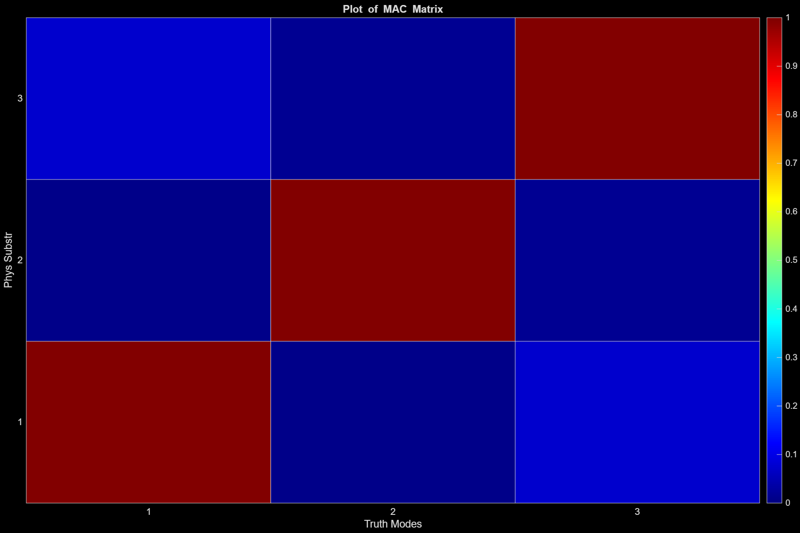

So what do we lose? Nothing?!?! Magic!
Truth
Physical Substructuring
Modal Substructuring
Mode # | Natural Frequency
1 | 10.86
2 | 23.81
3 | 29.85
Mode # | Natural Frequency
1 | 10.86
2 | 23.81
3 | 29.85
Mode # | Natural Frequency
1 | 10.86
2 | 23.81
3 | 29.85

Slide 23
Informal Formal Discussion
What are the three steps to setting up a substructuring problem?
In CMS our constraints often satisfy which condition? What does this mean about equilibrium?

Slide 24
Modal Truncation

Slide 25
Let’s look at a bigger example (10 DOF systems)
10 DOF
m_{a}
m_{a}
m_{a}
…
m_{a}
m_{a}=10 kg
k_{a}= 1e9 N/m
Mode # | Frequency (Hz)
1 | 0.00
2 | 497.95
3 | 983.63
4 | 1445.10
5 | 1870.98
6 | 2250.79
7 | 2575.18
8 | 2836.16
9 | 3027.31
10 | 3143.91

Slide 26
Let’s look at a bigger example (10 DOF systems)
10 DOF
10 DOF
m_{a}
m_{a}
m_{a}
…
m_{a}
m_{b}
m_{b}
m_{b}
…
m_{b}
m_{a}=10 kg
k_{a}= 1e9 N/m
m_{b}=8 kg
k_{b}= 1.2e9 N/m
Mode # | Frequency (Hz)
1 | 0.00
2 | 497.95
3 | 983.63
4 | 1445.10
5 | 1870.98
6 | 2250.79
7 | 2575.18
8 | 2836.16
9 | 3027.31
10 | 3143.91
Mode # | Frequency (Hz)
1 | 0.00
2 | 609.86
3 | 1204.70
4 | 1769.87
5 | 2291.47
6 | 2756.64
7 | 3153.94
8 | 3473.57
9 | 3707.68
10 | 3850.49

Slide 27
Let’s look at a bigger example (10 DOF systems)
10 DOF
10 DOF
m_{a}
m_{a}
m_{a}
…
m_{a}
m_{b}
m_{b}
m_{b}
…
m_{b}
m_{a}=10 kg
k_{a}= 1e9 N/m
m_{b}=8 kg
k_{b}= 1.2e9 N/m
$$\left[\begin{matrix}I_{a} & 0 \\ 0 & I_{b}\end{matrix}\right]\left\{\begin{matrix}\ddot{q_{a}} \\ \ddot{q_{b}}\end{matrix}\right\}+\left[\begin{matrix}2{\text{ζ}}_{a}ω_{n,a} & 0 \\ 0 & 2{\text{ζ}}_{b}ω_{n,b}\end{matrix}\right]\left\{\begin{matrix}\dot{q_{a}} \\ \dot{q_{b}}\end{matrix}\right\}+\left[\begin{matrix}ω_{n,a}^{2} & 0 \\ 0 & ω_{n,b}^{2}\end{matrix}\right]\left\{\begin{matrix}q_{a} \\ q_{b}\end{matrix}\right\}=\left\{\begin{matrix}φ_{a}^{T}F_{a} \\ φ_{b}^{T}F_{b}\end{matrix}\right\}$$
Let’s assume we only have data to 1000 Hz

Slide 28
Let’s look at a bigger example (10 DOF systems)
10 DOF
10 DOF
m_{a}
m_{a}
m_{a}
…
m_{a}
m_{b}
m_{b}
m_{b}
…
m_{b}
m_{a}=10 kg
k_{a}= 1e9 N/m
m_{b}=8 kg
k_{b}= 1.2e9 N/m
Mode # | Frequency (Hz)
1 | 0.00
2 | 497.95
3 | 983.63
4 | 1445.10
5 | 1870.98
6 | 2250.79
7 | 2575.18
8 | 2836.16
9 | 3027.31
10 | 3143.91
Mode # | Frequency (Hz)
1 | 0.00
2 | 609.86
3 | 1204.70
4 | 1769.87
5 | 2291.47
6 | 2756.64
7 | 3153.94
8 | 3473.57
9 | 3707.68
10 | 3850.49
Let’s assume we only have data to 1000 Hz

Slide 29
Let’s look at a bigger example (10 DOF systems)
10 DOF
10 DOF
m_{a}
m_{a}
m_{a}
…
m_{a}
m_{b}
m_{b}
m_{b}
…
m_{b}
Truth
Modal Substructuring
Mode # | Natural Frequency
1 | 0
2 | 289.29
3 | 550.25
4 | 850.88
Mode # | Natural Frequency | Error %
1 | 0 | 0%
2 | 308.43 | +6.6%
3 | 554.13 | +0.7%
4 | 901.91 | +5.9%
Whoa! What’s going on?

Slide 30
What happened?
We took two 10-DOF systems (20 DOFs) and reduced that to 5 modes (5 DOFs) so errors are caused by modal truncation.
Let’s grab a different number of modes, 5 from each system.
Mode # | Frequency (Hz)
1 | 0.00
2 | 497.95
3 | 983.63
4 | 1445.10
5 | 1870.98
6 | 2250.79
7 | 2575.18
8 | 2836.16
9 | 3027.31
10 | 3143.91
Mode # | Frequency (Hz)
1 | 0.00
2 | 609.86
3 | 1204.70
4 | 1769.87
5 | 2291.47
6 | 2756.64
7 | 3153.94
8 | 3473.57
9 | 3707.68
10 | 3850.49

Slide 31
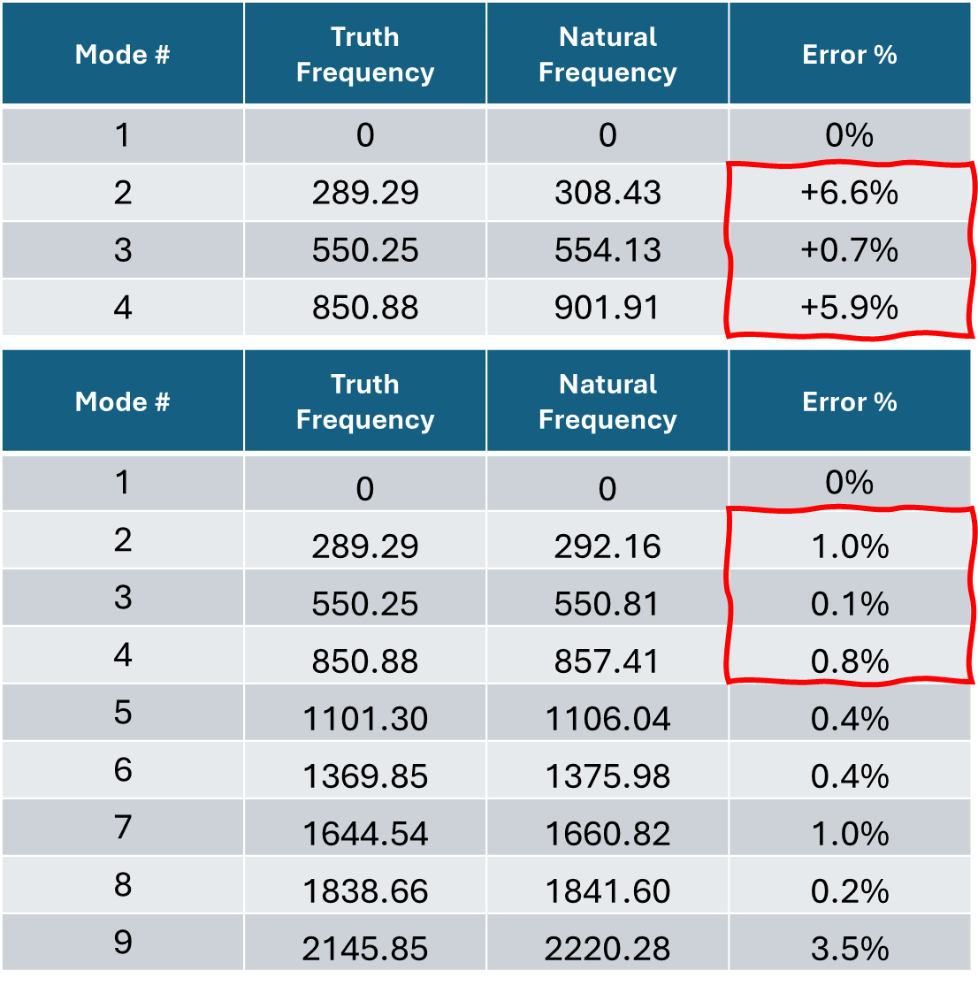
Can we pick the right modes?
As we include more information we drive down error
A good heuristic is to include content from twice the bandwidth of interest in subcomponent models
# modes A: 3
# modes B: 2
# modes A: 5
# modes B: 5

Slide 32
Informal Formal Discussion
Model reduction does remove some information from our subcomponent models. How do we determine if we’ve retained enough information?
If we retain all the modes of the subassemblies is our answer exact?

Slide 33
Conclusions

Slide 34
More experimental considerations after lunch!
Transmission Simulator Method
Other ROM forms
Constraint Weakening
Mode Selection
Instrumentation Concerns
Nonlinearities

Slide 35
CMS Wrap-Up
Component mode synthesis aims to couple two components (or subsystems) through a pair of reduced-order models. How much we can reduce the model and what reduction form are rich engineering decisions.
A reduced-order model is a simpler representation of a mechanical system often viewed through a set of basis-vectors. Choosing which vectors to keep or remove provides ample means of model reduction.
We follow a similar primal assembly to physical substructuring but project our constraints (and coupled solutions) into a reduced domain.

Slide 36
Next Up – Classroom Examples!

